Slide 1

Basics of Neural Network Programming
Binary Classification
deeplearning.ai
Notes:
There are some implementation techniques that are important while implementing neural networks.
For example, we don’t want to loop through all the m training examples.
Learning too should be organized in a forward pass, backward pass fashion., we will learn how learning can be done in this way.
In this week, we will do binary classification using logistic regression.

Slide 2
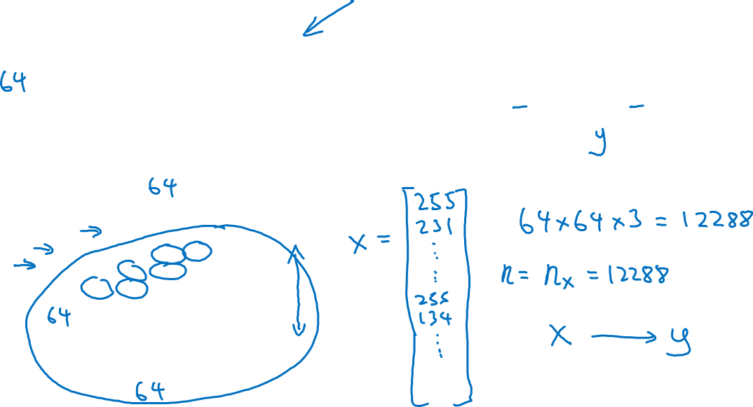
Binary Classification
1 (cat) vs 0 (non cat)
Blue
Green
Red
Notes:
Computers store images in RGB matrix – 3 matrices for 3 color channels.
Normally each pixel value is a tuple with 3 values & each representing its value for the color red, green & blue.
Therefore when we store the image, we store in matrices.
For example if the image is 64 X 64 pixel means 3 64 by 64 matrices
It will be stored in terms of 64 by 64 red, 64X64 green & blue.
To turn the pixel matrices into feature values We need to unroll these pixel intensity values from these matrices into a feature vector X. we get a very long feature vector listing all Red, green, blue pixel values. The total length of this vector is 64*64*3
In binary classification, we want to predict given an image we label whether it is cat or not.
‘
Nx is to represent the dimension of input feature matrix.

Slide 3
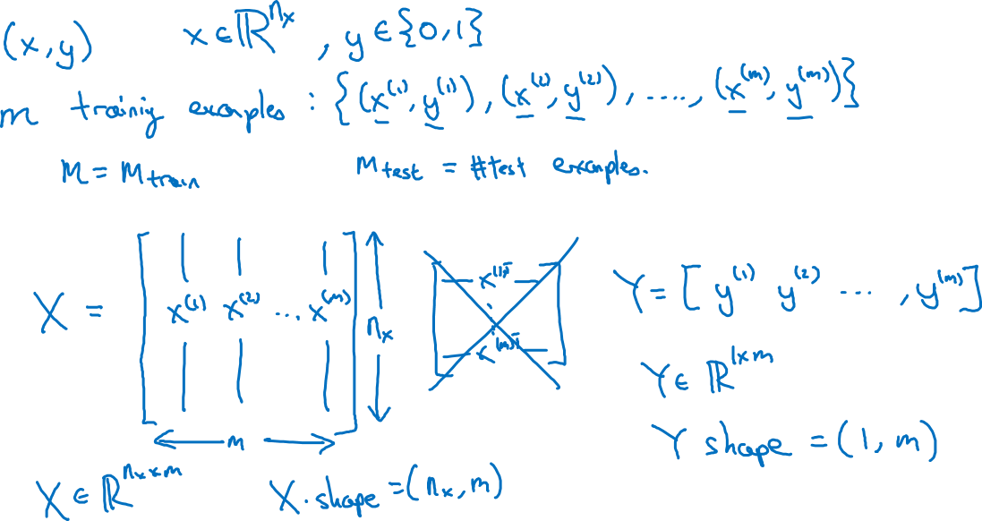
Notation
Notes:
x is our feature vector.
We are stacking our data examples as columns rather than rows.
In some courses, matrix X is defined in rows however when we are implementing the left implementation makes it easier.
Here it must be noted that we are using m rows & nx columns, where m represents the number of training example & Nx represents the length of feature vector.
Similarly y will be 1 row and m columns because it makes implementation easier.
We must stack data Xs, Ys in different columns.

Slide 4
Shapes
X is n,m
Y is 1,m

